Slide 1
Metatransciptomics
Alastair Grant
Environmental Sciences, University of East Anglia

Slide 2
Definition: Metatranscriptomics is the study of the function and activity of the complete set of transcripts (RNA-seq) from environmental samples.
http://www.metagenomics.wiki/pdf/definition/metatranscriptomics

Slide 3
Hot topic WoK search (topic: metatranscriptom*)
15th September 2016
494 hits
22 of them “highly cited”
Is it for you???????????
Notes:
Stop and think – what would you hope to get out of a metatranscriptomic study?

Slide 4
Total RNA or mRNA?
Environmental RNA is 90-98% rRNA
rRNA gives unbiased measure of taxonomy
C.f. Turner et al, 2013
But not much mRNA
So not much functional information

Slide 5
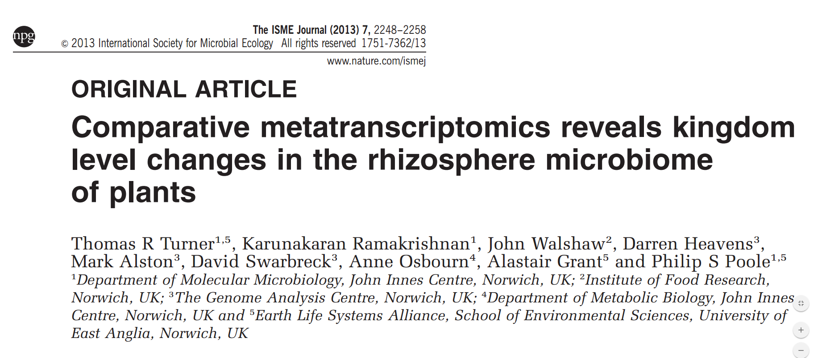
Total RNA: Turner et al, 2013, ISME J, 7:2248
Taxonomic identification using SSU and LSU RNA
Notes:
Total RNA does have some substantial advantages

Slide 6
Allows assessment of relative abundances, without PCR bias
Notes:
Big difference in Eukaryote abundance. Fungi abundant in Pea. Nematodes common in Oat. Would have been difficult to see using PCR amplified SSU

Slide 7
Total RNA
Turner et al, 2013,
ISME J, 7:2248
Notes:
Wheat has least effect. Oat and pea have bigger effects. Avenicin minus oat has large effect on Eukaryotes, but not on bacteria.
But I should say, that we only wrote this paper because we were having such a struggle to deplete rRNA

Slide 8
But assuming you still want to look at function….

Slide 9
First isolate your mRNA
But bacterial mRNA lacks poly-A tail
Get rid of rRNA
Hybridisation
MicrobeExpress (Ambion)
Sample specific 16S and 23S probes (Stewart et al, 2010)
Ribo-Zero (Epicentre)
Duplex specific nuclease (Yi et al, 2011)
MEssageAmp (Ambion – adds a poly-A tail)
Notes:
There are papers that make it sound easy – Tom Turner tried most of these, and I know we weren’t the only ones to find it challenging

Slide 10
Best solution for us……
4:1 Ribo-Zero bacteria: Ribo-Zero plant root/seed
Usually ~10% reads were rRNA
Intact RNA is important
Notes:
Working in rhizosphere –so plant roots were an issue. Others have come out in favour of Ribo-Zero

Slide 11
Using internal standard allows quantification
Gifford et al, 2011
Moran et al, 2013
Prepare known RNA molecule
Spike into sample before extraction at known concentration
Compare # reads of spike with # reads of each mRNA
Helpful in studies of environmental function (e.g. biogeochemistry)
Estimates ~200 mRNA molecules/cell
Half-lives of 1-8 minutes
Notes:
Something that is common practice in some areas of analytical chemistry, but is novel to many
Useful in looking at functional activity in the environment. Less important for experimental comparisons.

Slide 12
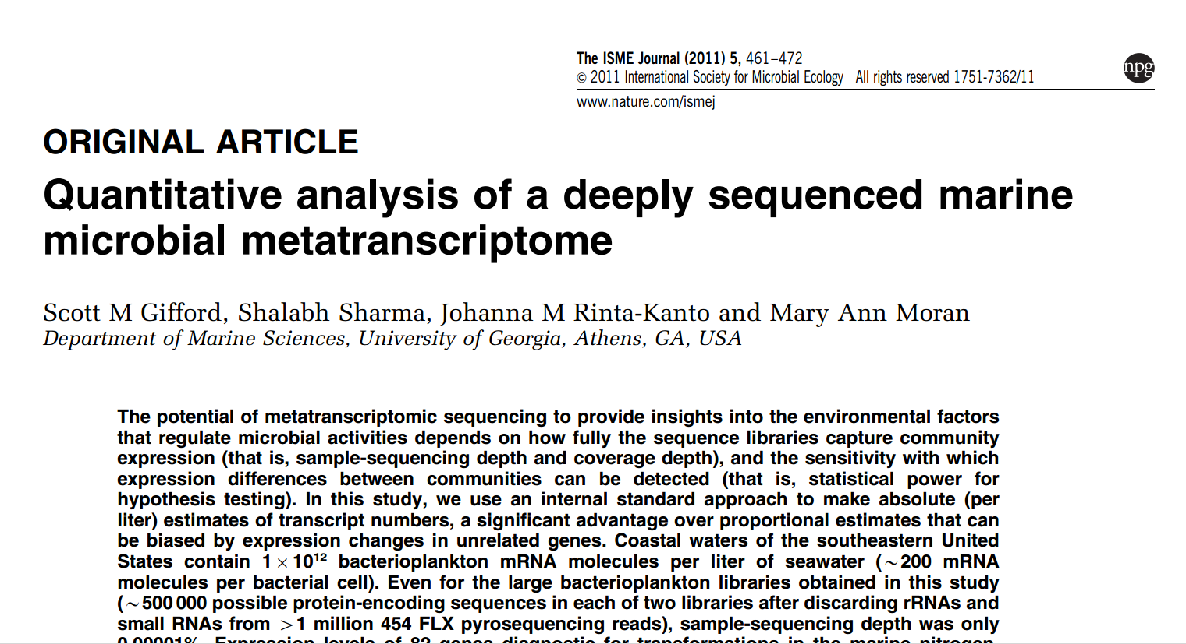

Slide 13
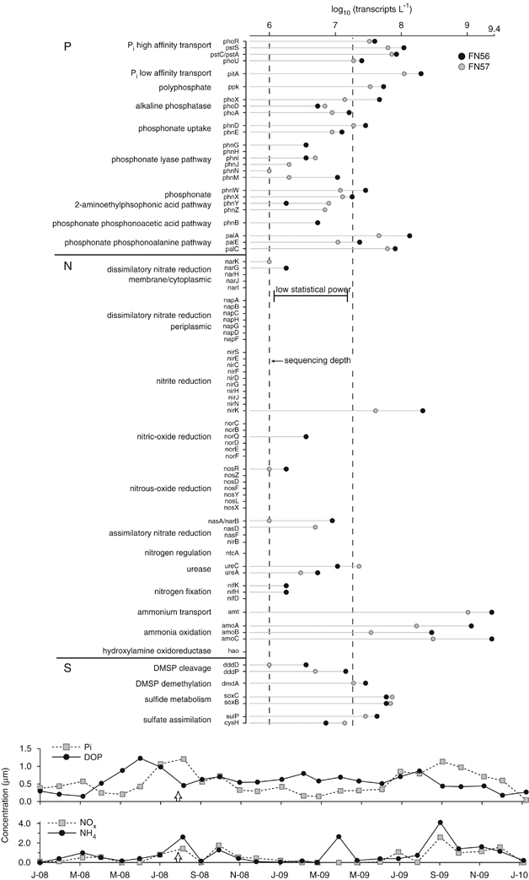

Slide 14
Gifford et al., 2011
Genes for Ammonia processing abundant
NirK only other abundant N processing gene (nitrite)
S processing surprisingly high

Slide 15
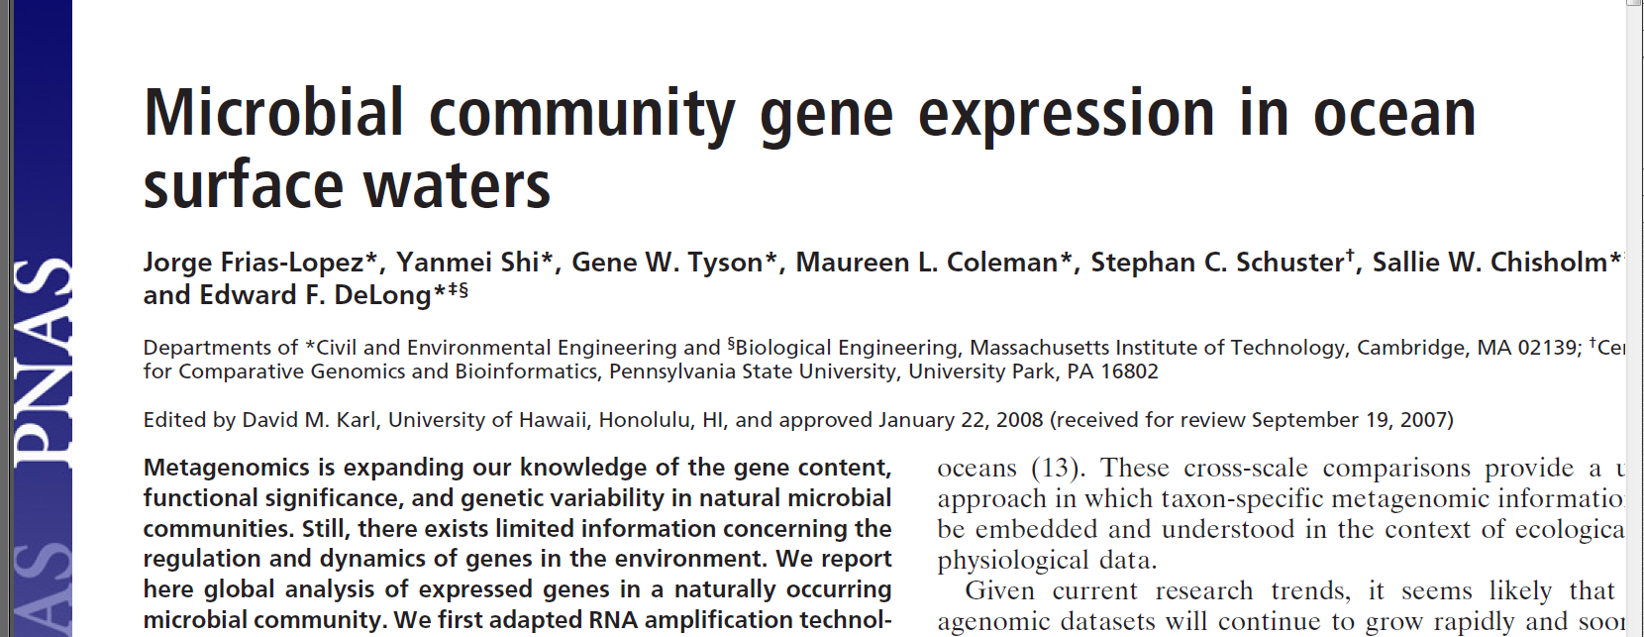

Slide 16
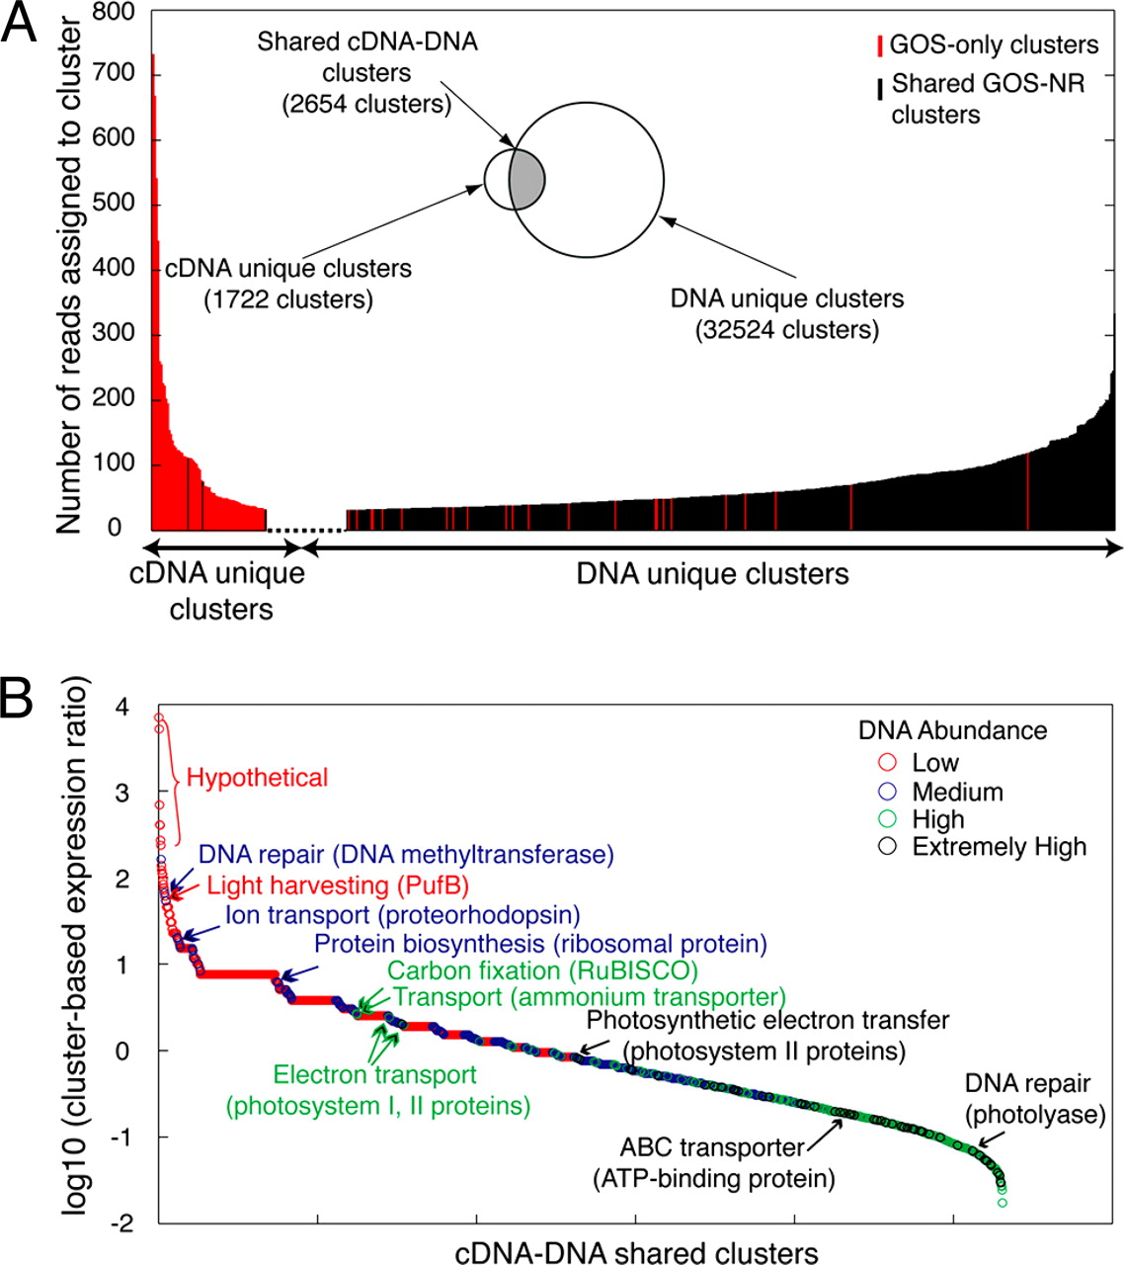
Community-level gene expression profile based on GOS peptide database.
Jorge Frias-Lopez et al. PNAS 2008
50% of transcripts were unique
?databases dominated by culturables?
©2008 by National Academy of Sciences
Notes:
Community-level gene expression profile based on GOS peptide database. (A) GOS protein clusters with DNA or cDNA matches at bit scores ≥40 are shown in the Venn diagram. Numbers of reads assigned to GOS protein clusters, when >70, are plotted for both cDNA-unique protein clusters and DNA-unique protein clusters. GOS protein clusters shared by DNA and cDNA libraries (shaded in gray) were further illustrated in B. (B) GOS protein clusters shared by cDNA and DNA libraries were ranked by their cluster-based expression ratio (representation of each cluster in the cDNA library normalized by its representation in the DNA library). Furthermore, each protein cluster was categorized (and color-coded) according to its abundance in the DNA library. Representative protein clusters were highlighted from each category and discussed in the text.

Slide 17
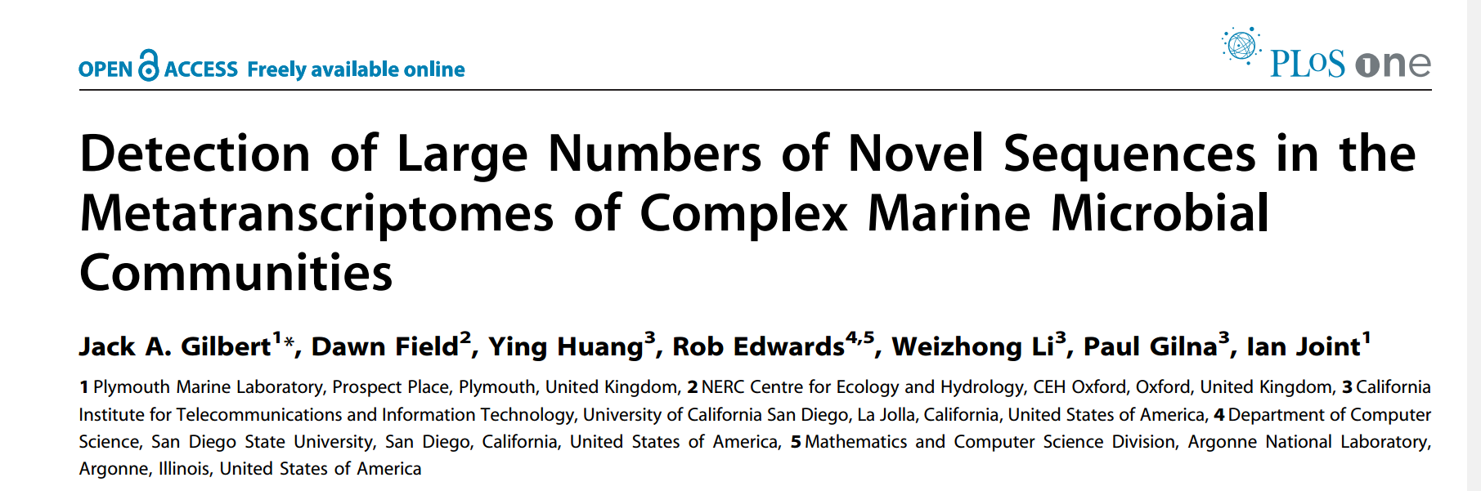
91% of gene families from mRNA were novel
Only 29% of those from DNA were novel

Slide 18
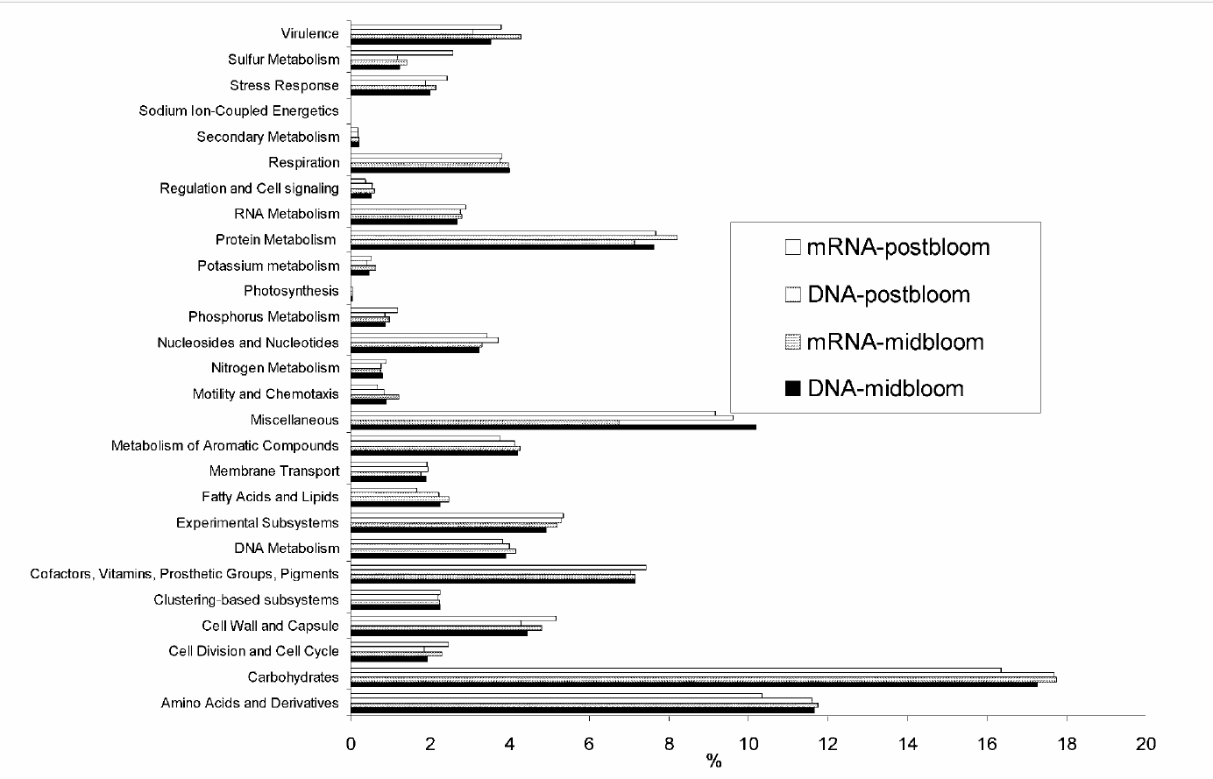

Slide 19
Summary so far….
We get information on what is going on
But lots of this activity is uncharacterised

Slide 20
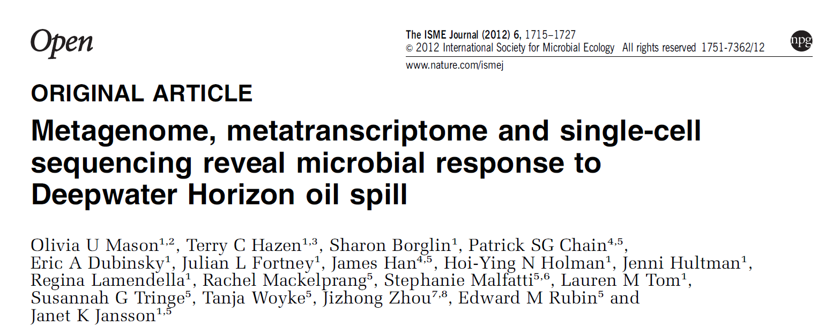
Notes:
Comparing metagenome; metatranscriptome and single cell genome sequences can be helpful….

Slide 21
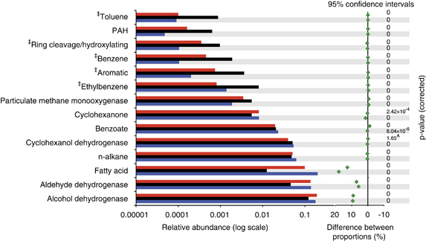
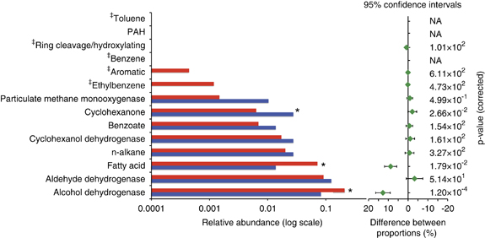
Metagenome Metatranscriptome
Black = clean Blue = moderate Red = severe pollution
Notes:
No metatranscriptome data for uncontaminated sample

Slide 22
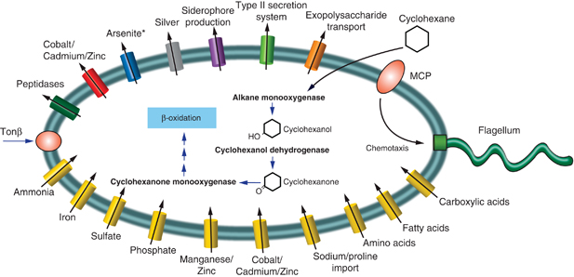
Oceanospirillales – 80-90% of individuals in plume
Draft genome from single cell sequencing.
All genes in metagenome. Most expressed in metatranscriptome
Notes:
But this is a pretty gross insult to the community, and the impacted community is very low diversity

Slide 23
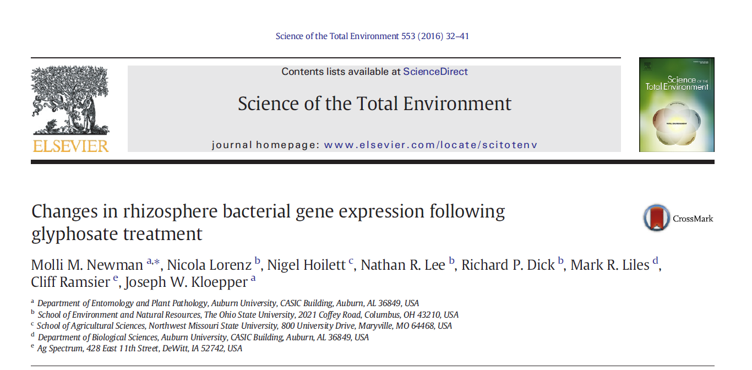
Notes:
At the other end of the spectrum…

Slide 24
abstract
“Transcripts down regulated following glyphosate treatment involved carbohydrate and amino acid metabolism, and upregulated transcripts involved protein metabolism and respiration”

Slide 25
Notes:
But the reality is pretty subtle – a bit depressing to go to all of that effort and find such small changes.
Go for gross differences! – without that, the core metabolism is inevitably fairly similar.

Slide 26
Making sense of the data
An example pipeline – not necessarily the best

Slide 27
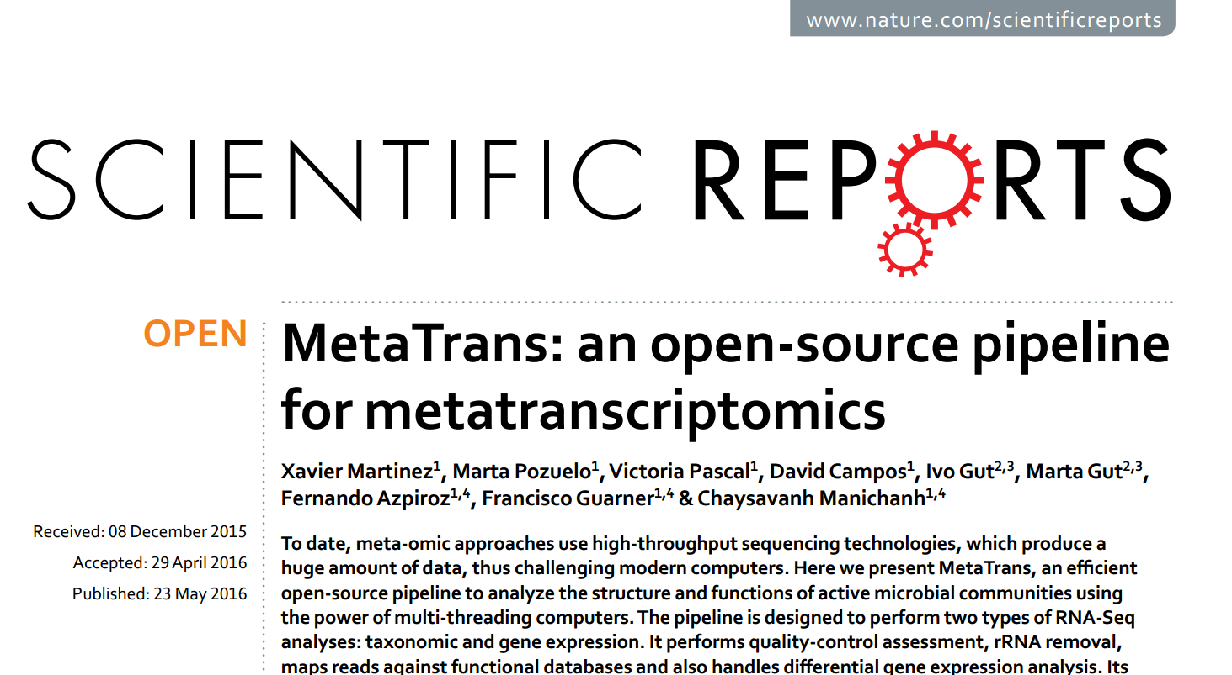

Slide 28
Martinez et al, 2016, Scientific Reports

Slide 29
After “flatulogenic diet” – functional categories

Slide 30
After “flatulogenic diet” – Orthologous IDs

Slide 31
Notes:
Downregulated functions are coloured

Slide 32
But all this is based on assigning 1.85% of high quality reads

Slide 33
Bioinformatics
Remove rRNA (e.g. SortMeRNA)
Quality screening (e.g. Sickle)
Blastx (Rapsearch2 or Diamond – not Blast)
Taxonomic classification (e.g. MEGAN)
Functional annotation (into Seed or KEGG categories)
Clustering (e.g. CD-Hit) or assembling (e.g. Trinity)
Mapping reads to clusters/contigs (e.g. RSEM)
Differential expression (e.g. DESeq2)

Slide 34
Three ways of viewing the data
Contigs or clusters
A bit of each
Taxonomy
What is it from?
Function
What does it do?

Slide 35
Of high quality reads….
11% of high quality reads have matches in NR
68.2% of 200+bp contigs had matches in NR
67.7% had matches in Uniprot
7% of remainder had Blastn hits in NT
35% of reads mapped to contigs
But only 13% to annotated contigs
Many highly abundant but unidentified contigs.
Lots of short and/or rare transcripts (65%)

Slide 36
Conclusions
Total RNA is a good place to start
Unbiassed and comprehensive community composition
mRNA tells us about functions
More work than metagenomes
Much more work than 16S amplicons
Unidentifiable transcripts a bit of a mystery
More common than in metagenomes
Novel biochemical pathways?
Or something we’ve not thought of?
A challenge, but potentially a big reward

